Slide 1
Plant Leaf Disease Detection by using Image Processing
By,
S. Mathumitha(2112116)
P. Abinaya(2112117)
S. Sandhiya(2112085)

Slide 2
INTRODUCTION
An AI-based plant leaf disease detection system is developed using machine learning and computer vision techniques. The system aimed to identify diseases accurately and at an early stage, allowing farmers to take timely action.
This technology has the potential to monitor and manage the plant health

Slide 3
Problem Statement
Early and accurate detection of plant leaf diseases is crucial in ensuring the health and productivity of crops.
They can spread quickly and cause significant damage to crops,resulting in lower yields and economical loss to the formers .
Early detection allows for targeted treatment and prevention.
With the help of computer vision and image processing we can detect the leaf diseases early and accurately .

Slide 4
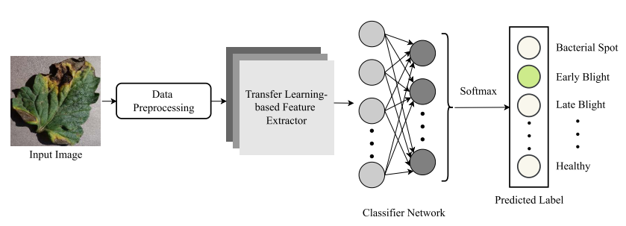
Overview of the tomato leaf disease classification architecture.

Slide 5
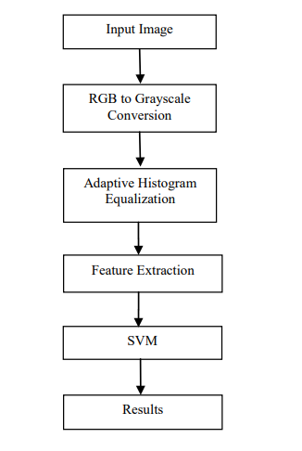
Methodology
Input: Images of leaves.
Output: Name of the diseases.
The RBG color components of the images are transformed into Grayscale components.
Adaptive Histogram Equalization is applied.
Foe texture extraction GLCM is utilized.
Classification of diseases using SVM classifiers.
Display the results.

Slide 6
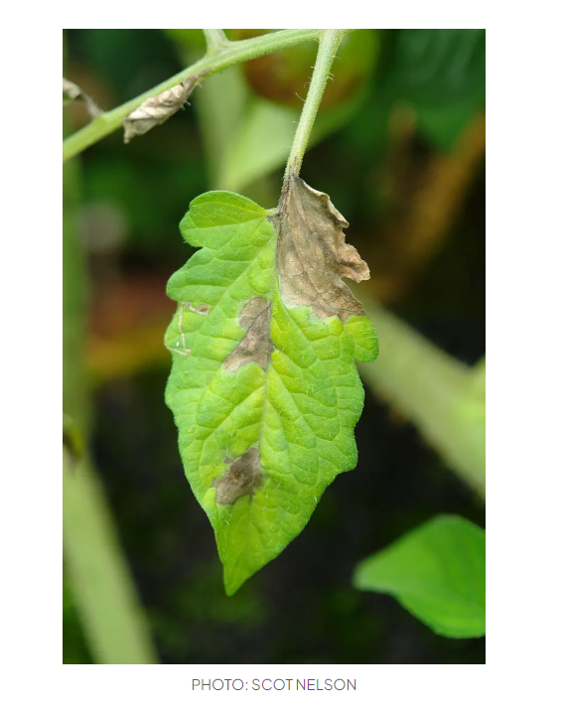
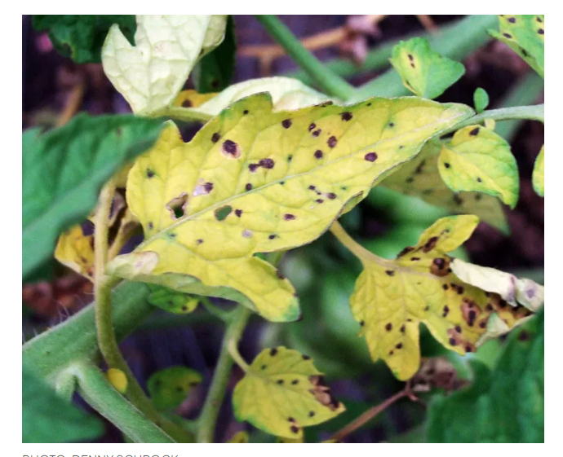
INPUT:
INPUT:
OUTPUT:
Early Blight
OUTPUT:
Septoria Leaf Spot

Slide 7
GrayScale Conversion:
A RGB photograph is basically a M*N*3 array of color pixel, in which each color pixel is a triplet which corresponds to red, blue and green shade issue of RGB image at a specific spatial location.
Grayscaling is the process of converting an image from other color spaces e.g. RGB, CMYK, HSV, etc. to shades of gray. It varies between complete black and complete white.
A Grayscale picture may be regarded as a single layered image.

Slide 8
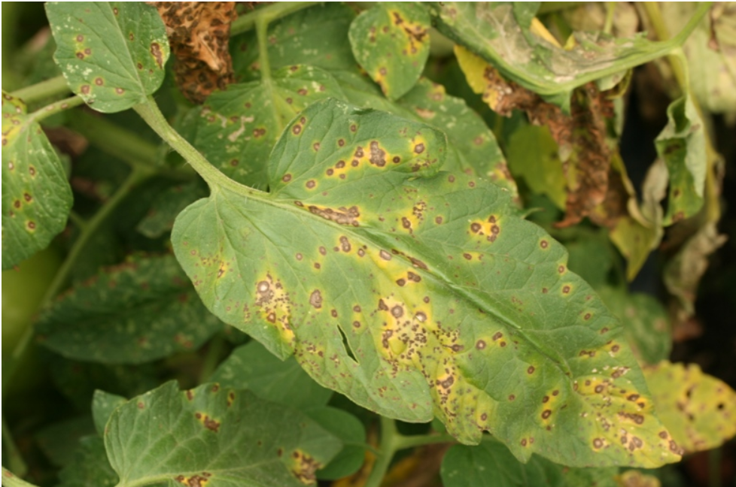
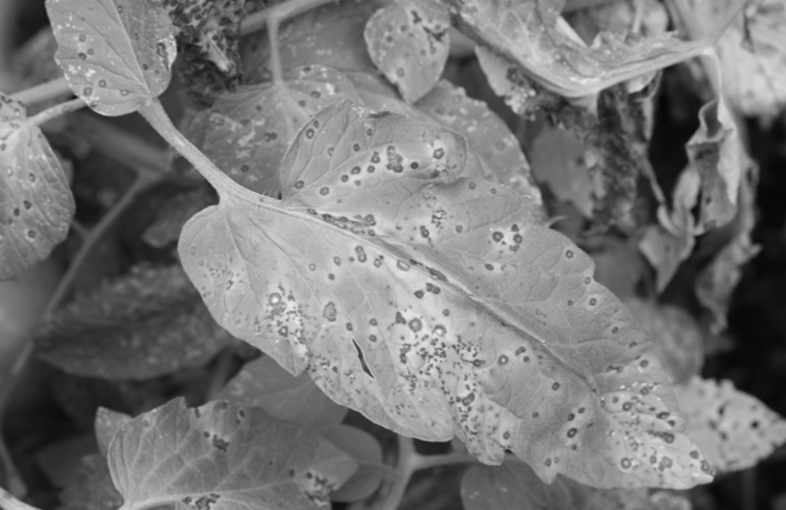
GrayScale Conversion:

Slide 9
Contrast Limited Adaptive Histogram Equalization:
AHE is used for improvising the contrast and edges in the input picture.
CLAHE is a modified part of AHE.
CLAHE increases the contrast between diseased spots and the leaf by dividing the image into multiple small regions.
It applies a transformation function that is proportional to a cumulative distribution function.

Slide 10
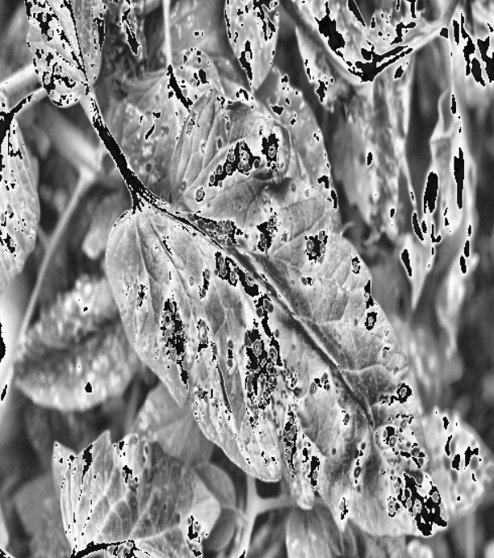
Adaptive Histogram Equalization:

Slide 11
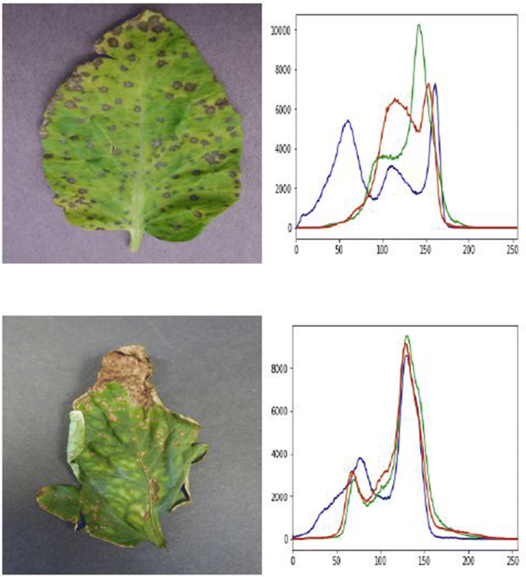
Feature Extraction:
The majority of the diseases that corrupt the plant can be scrutinized by discoloration of leaves, or the presence of residue on the leaves thereby converting the natural texture of the leaves.
To extract the leaves texture features, the Gray-Level Co-occurrence matrix (GLCM) and Principal Component Analysis (PCA) algorithms have been considered. The Algorithms are trained by 390 leaves to classify 13 kinds of plants with 65 new or deformed leaves images.

Slide 12
CLASSIFICATION
SVM:
An algorithm to classify the data into different classes.
SVM draws a decision boundary i.e, a hyperlane between any two classes to classify them.
Steps involved:
Generate hyperlanes that segregate the classes in the best way.
Select the best hyperlane with maximum distance between the support vectors.

Slide 13
Libraries
The seaborn library is used to provide the dataset we’ll be using 'and use the pairplot() function to better understand our data.
matplotlib.pyplot to show and modify our visualizations
Pandas is used to manipulate our data via DataFrame methods
The SVC class is used to create our classification model
The train_test_split() function is used to split our data into training and testing data
The accuracy_score() function allows us to evaluate the performance of our model

Slide 14
Implementation
Import necessary libraries
Insert the desired number of features
Train the model
Predicting the output and print the accuracy of the model
Plotting the classifier

Slide 15
THANK YOU!

